Slide 1

TEMPORAL
METRICS
Cammie Newmyer
$$C_{r}=\frac{Δt}{\frac{d}{r}}$$

Slide 2
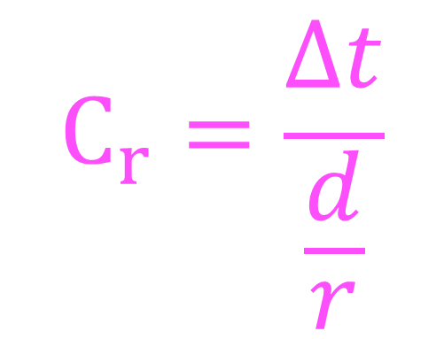
Temporal Metrics
$$C_{r}=\frac{Δt}{\frac{d}{r}}$$
Using mathematics, Artificial Intelligence, data science principles, and machine learning methods to develop a deep learning, artificial neural network, multi-class, classification model to answer the question of how humans perceive time.
Cammie R Newmyer
December 7, 2023
Regis University, MSDS Practicum II

Slide 3

Have you ever questioned why your perception of time varies?
Hourly
Daily
Lifetime
You are working on a task and you can’t stay awake – it is so boring and time is moving incredibly slow?
You have a day where you wonder where the time went, it just flew by and you didn’t accomplish anything?
You feel like time just moved too fast or too slowly over periods of your life?
Have you ever wondered if you can do anything about it?

Slide 4

Temporal Metrics Part I
Goals:
Methods:
Use AI Chat GPT 4.0 to estimate the amount of time a person with a given condition would spend per 24 hour period in seven different brainwave states: delta, theta, alpha, low beta, mid beta, high beta, or gamma.
Use established mathematical formulas to calculate theoretical wavelength distance for all time spent in seven different brainwave states in a 24 hour period. Set a control distance for an “average person” to compare increases and decreases in distance, rate, and time.
Using features such as frequency, wavelength, distance, myelination, cycle, and time in each brainwave state, run a Random Forest, multi-class, classification model to develop a prediction model and analyze feature importance.
Develop a mathematical formula to predict the variation in how humans perceive time.
Develop a dataset.
Use the dataset to verify the reliability of the mathematical formula by building a machine learning, random forest, multi-class, classification model.
Use the model to predict which feature involved in the calculation and development of the Cammie_r constant is most likely to affect the perception of time and contribute to the accuracy of the model.

Slide 5
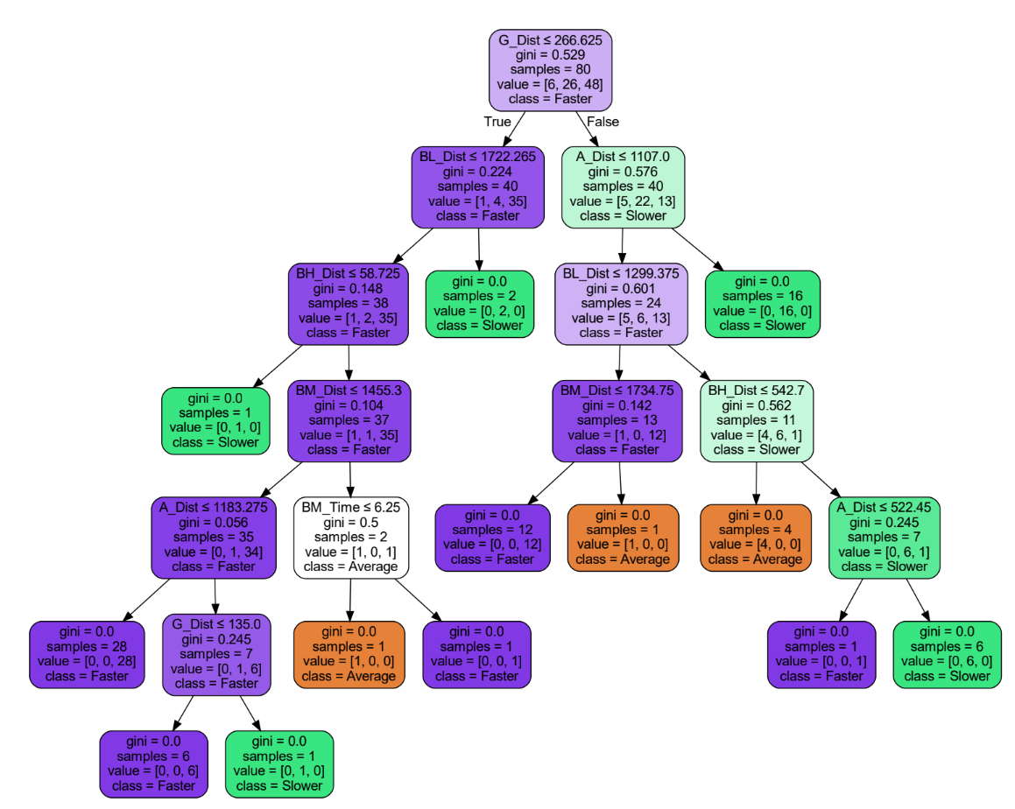
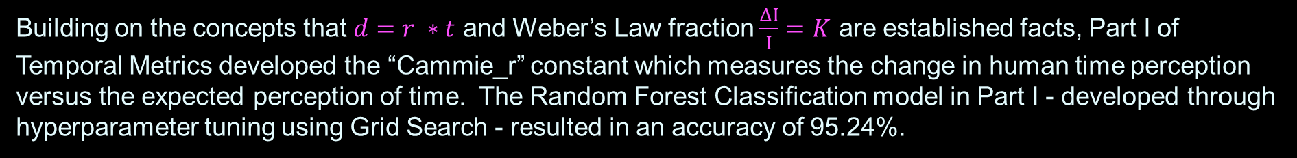
Temporal Metrics Part I Results
Building on the concepts that $d=r ∗t$ and Weber’s Law fraction $\frac{ΔI}{I}=K$ are established facts, Part I of Temporal Metrics developed the “Cammie_r” constant which measures the change in human time perception versus the expected perception of time. The Random Forest Classification model in Part I - developed through hyperparameter tuning using Grid Search - resulted in an accuracy of 95.24%.
Top 5 Key Contributing Features:
Myelination: 0.219146
Mid Beta Wavelength: 0.138901
Low Beta Wavelength: 0.130158
High Beta Wavelength: 0.082301
Gamma Distance: 0.042733

Slide 6
Temporal Metrics Part II
Goals:
Methods:
Use Artificial Intelligence, Large Language Model (LLM) Chat GPT 4.0 to estimate the likelihood that an adult in the US at a particular age and sex would experience a given condition.
Use Excel to generate the dataset with the value of the Cammie_r constant in the cell to indicate that a theoretical member of the population is positive for that condition.
Using conditions as features, and the Cammie_r constant to indicate that a person is positive for a condition at a given age and sex, build a deep learning, artificial neural network, multi-class, classification model to predict time perception as faster, slower, or average.
Develop the code for a user interface where the user can use the model to predict their perception of time and suggestions to alter it.
Using the Cammie_r constant developed in Part I, generate a synthetic dataset representative of the United States adult (ages 18-100) population with likelihood of developing conditions or possessing certain characteristics that are known to alter the perception of time.
Build a deep learning, artificial neural network multi-class classification model to predict the likelihood of altering the perception of time.
Build a user-interface where the user can choose age and sex, then from a list of possible conditions ranging from physical, lifestyle, psychological and generational use the model to predict if they are perceiving time as slower, faster, or average and offer suggestions regarding possible activities to alter that perception.

Slide 7
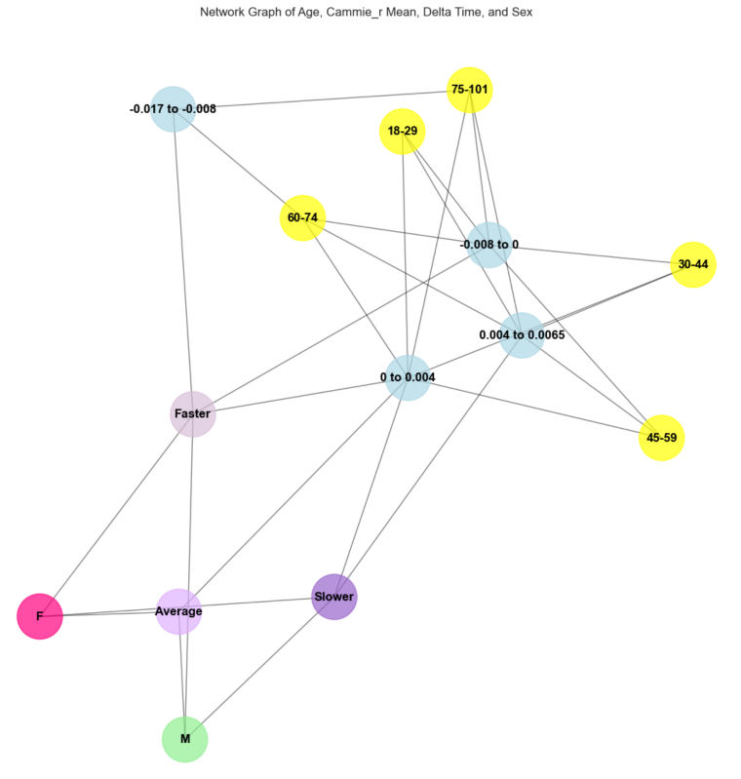
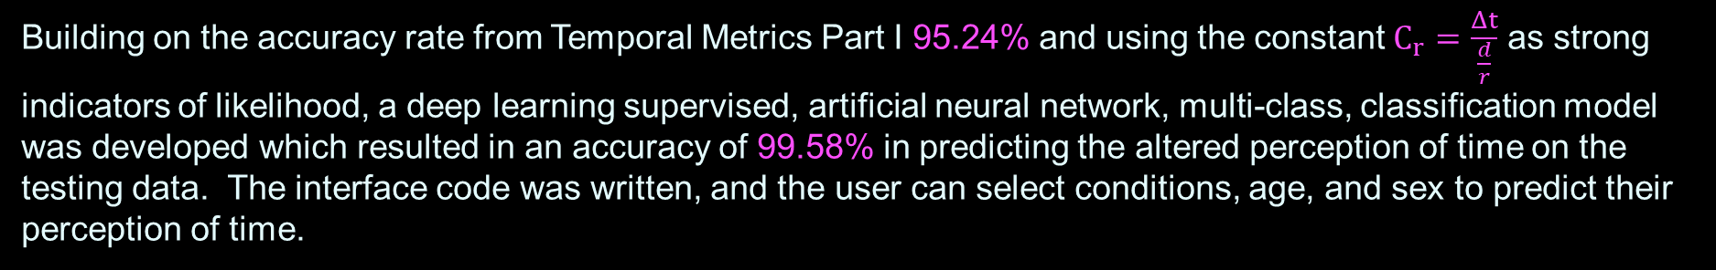
Temporal Metrics Part II Results
Building on the accuracy rate from Temporal Metrics Part I 95.24% and using the constant $C_{r}=\frac{Δt}{\frac{d}{r}}$ as strong indicators of likelihood, a deep learning supervised, artificial neural network, multi-class, classification model was developed which resulted in an accuracy of 99.58% in predicting the altered perception of time on the testing data. The interface code was written, and the user can select conditions, age, and sex to predict their perception of time.
Model Parameters:
Sequential
Density: 64, 32, 3
Activation: ReLU, ReLU, Softmax
Dropout: 0.5
Optimizer: Adam, Learning Rate 0.001
Loss: Categorical Crossentropy
Metrics: Accuracy
Early Stopping
100 Epochs

Slide 8
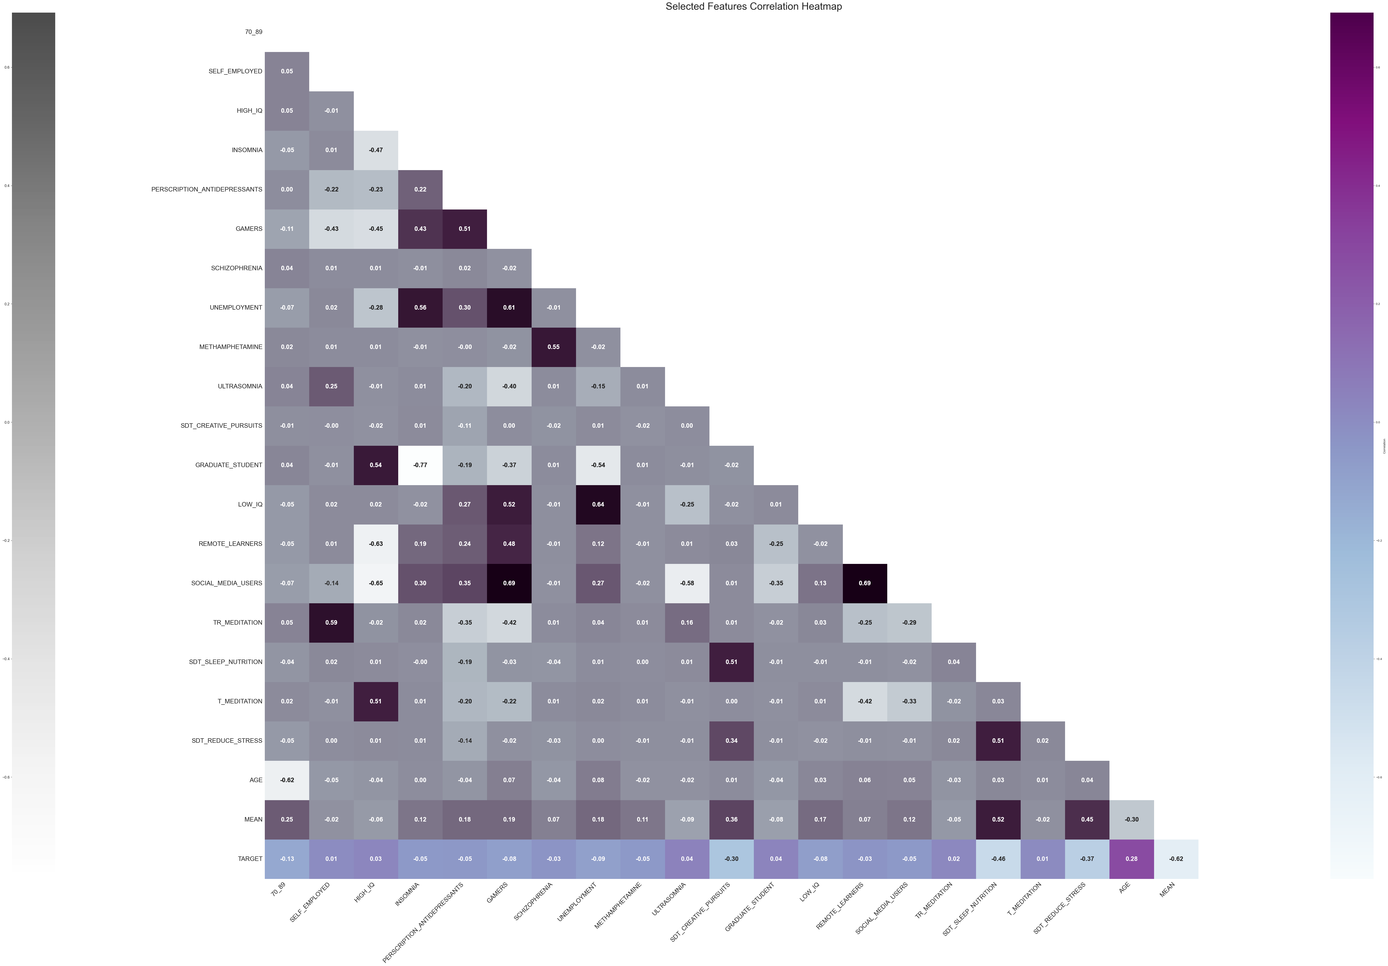
EDA Correlation Matrix Selected Features
(Bottom row is the perception of time).
Darker colors mean a strong positive correlation between the features and lighter means a strong negative correlation.

Slide 9
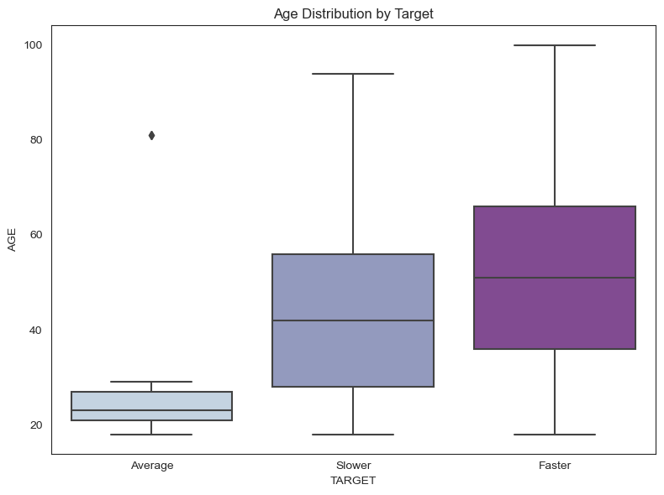
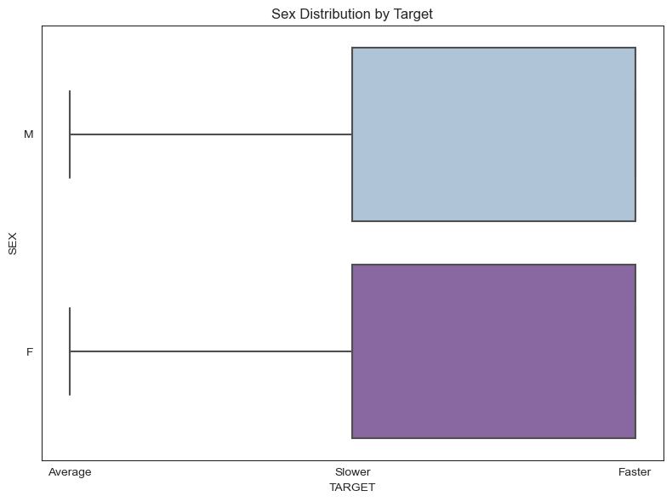
EDA Boxplots Age and Sex Distribution by Time Perception
As age increases time seems to speed up.
Sex does not alter how time is perceived.

Slide 10
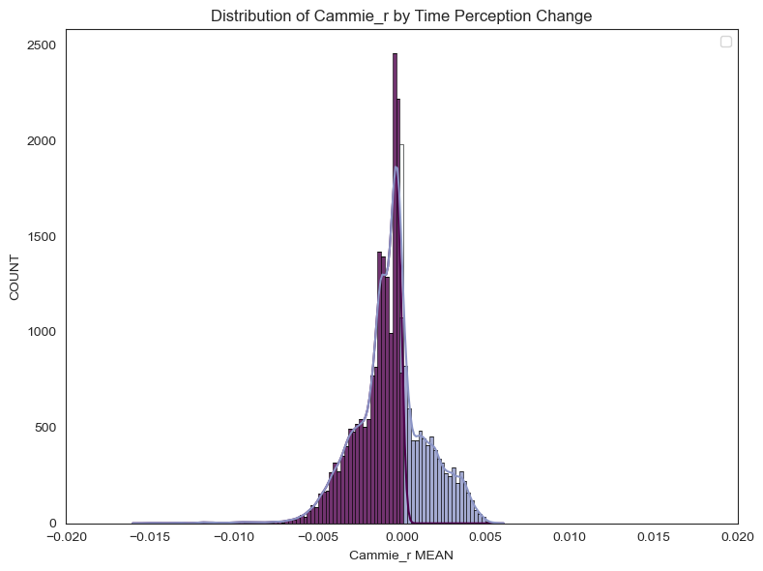
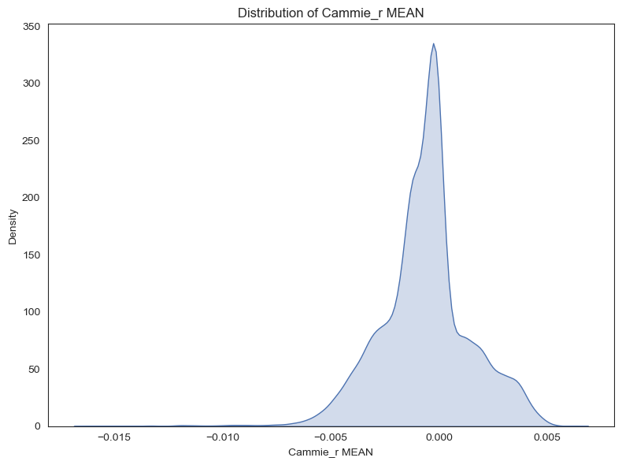
EDA Distribution and Density Plots
Distribution of C_{r} within the dataset.
(The data is skewed to time moving faster.)
Density of C_{r} within the dataset.
(The data is skewed to time moving faster.)

Slide 11
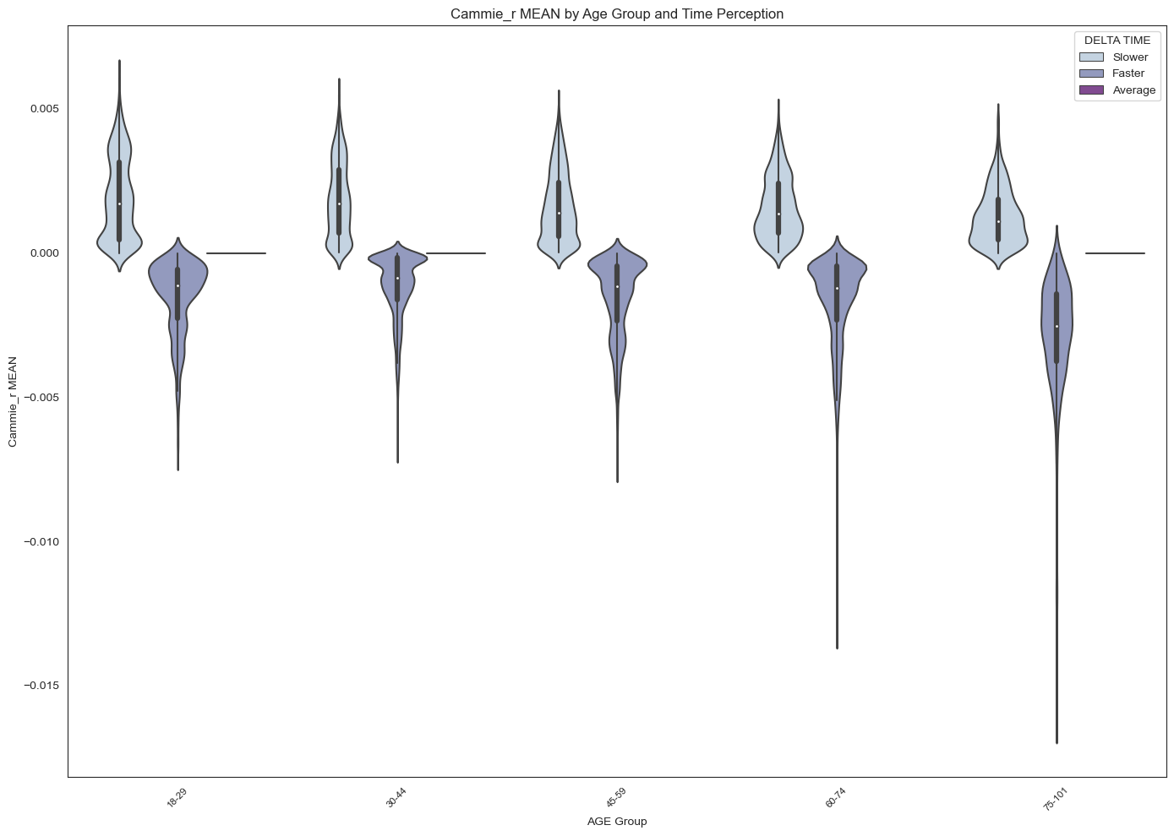
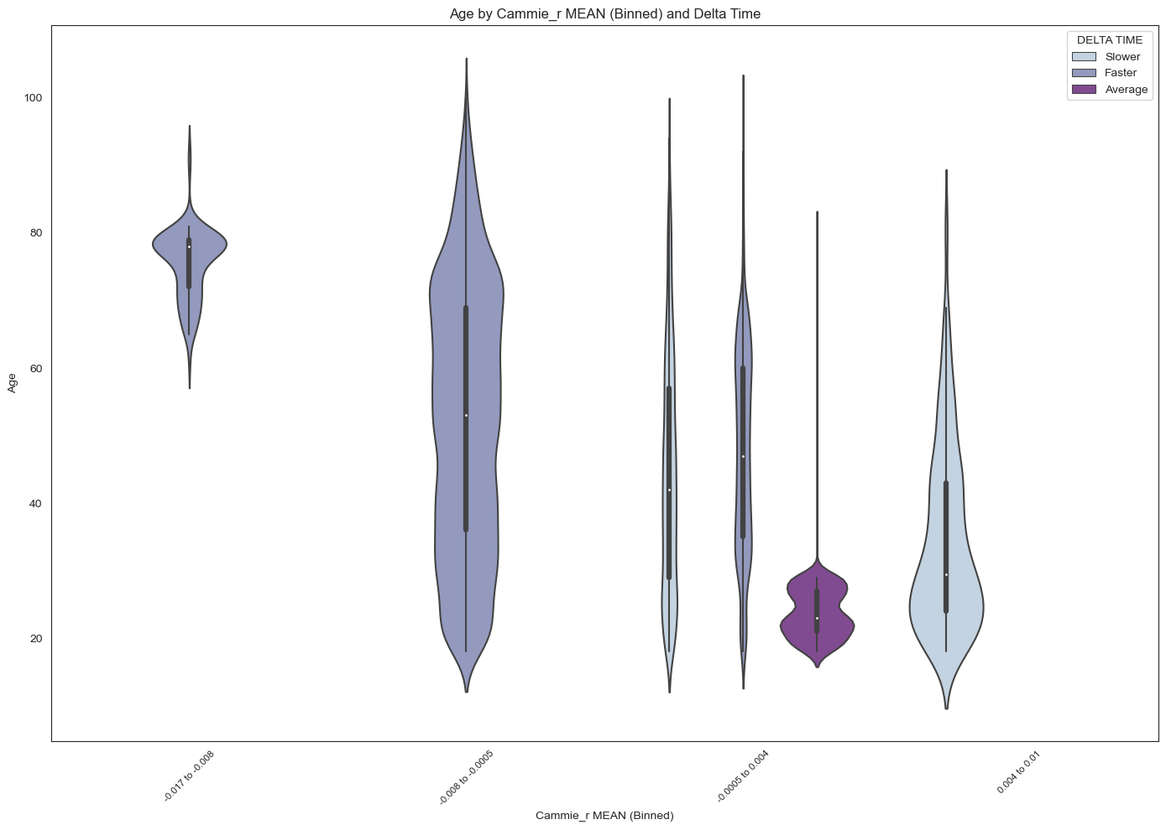
EDA Violin Plots Age and Sex Distribution by Time Perception
Density of C_{r} within Age Groups.
(As you age you experience time moving faster.)
Density of Age Groups by C_{r}.
(The data is skewed to perceive time slower the younger the subject is. The majority of average time perception occurs at younger ages as well.)

Slide 12
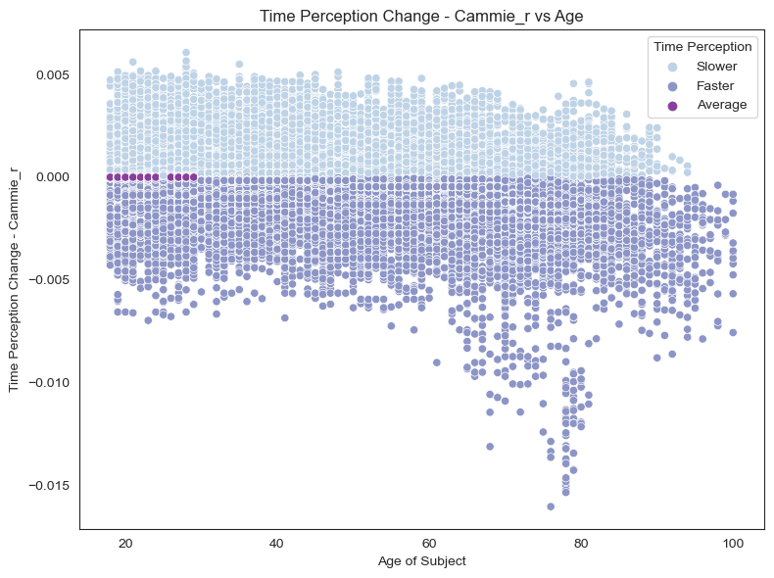
EDA Scatter Plot Age of Subject by C_{r}

Slide 13
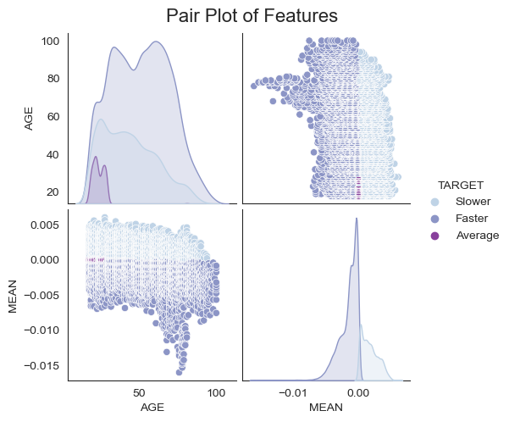
EDA Pair Plot Age of Subject by C_{r}

Slide 14
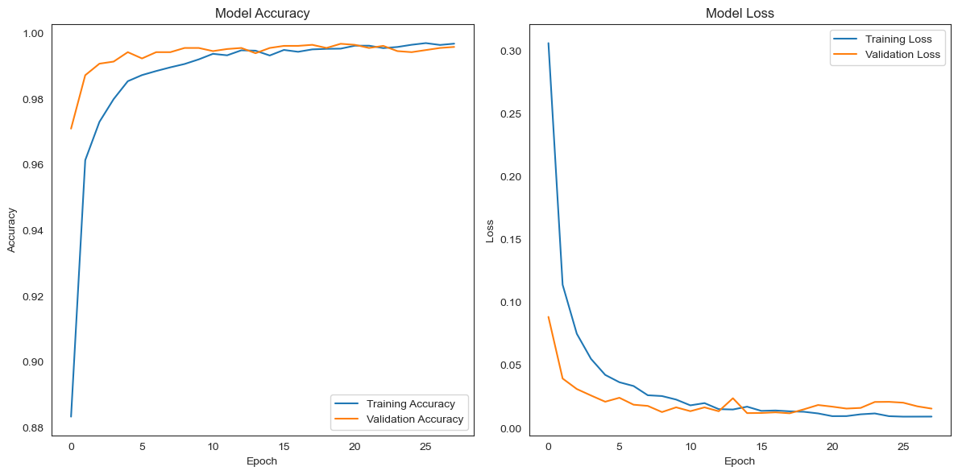
Model Performance Accuracy
Area Under the Curve (AUC)
The model is predicting with a higher level of accuracy the closer the curve gets to 1.
Receiver Operating Characteristic (ROC)

Slide 15
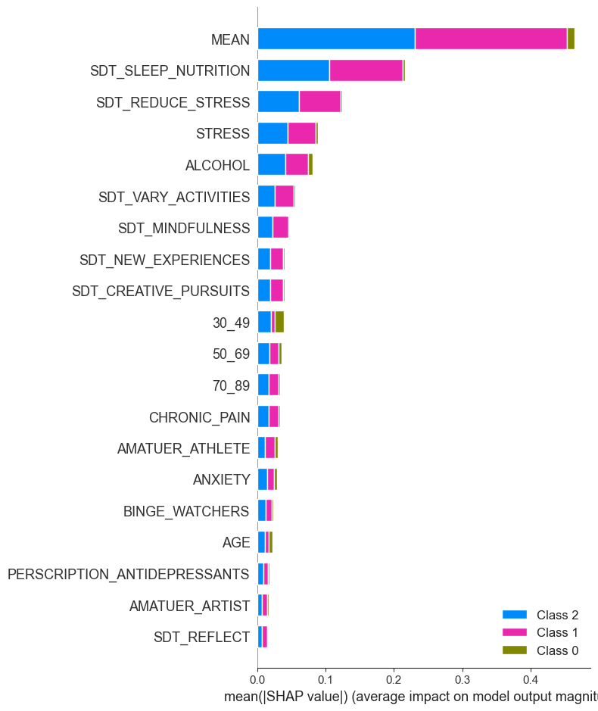
Model Performance Accuracy SHAP’s Kernel Explainer
Receiver Operating Characteristic (ROC)
Features Contributing the most to the accuracy of the model.

Slide 16
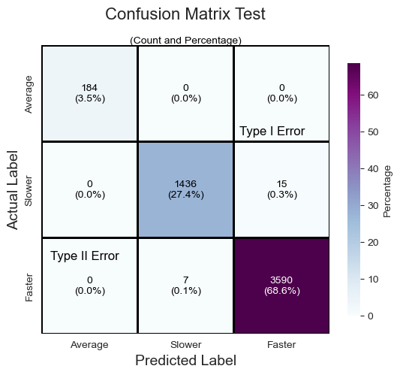
Model Performance Accuracy
Type 1 Error is predicting that something is true when it is not.
Type 2 Error is predicting that something is not true when it is.

Slide 17
Practical Applications Examples
Hourly
Daily
Lifetime
If you are bored and time moves slow – switch your brain from processing in alpha or low beta wave states to a higher frequency state by engaging in a creative activity, taking a walk, or listen to music.
Days just get away from you – time is moving too fast – switch your brain from processing in the high beta wave state associated with stress: stop multitasking, take a walk, or meditate.
Over your lifetime the most important thing you can do so time stays “average” or “slows down” is to increase the myelination in your brain and keep it healthy by participating in activities that are know to increase myelination (exercise, destress, sleep, be creative, learn something new, etc.) especially as you age.

Slide 18
KEY DISCOVERIES
The faster your brainwaves travel the slower you will perceive time.
Likewise, the slower your brainwaves travel the faster you will perceive time.
You can affect how you perceive time hourly, daily, weekly, monthly, yearly, and for your lifetime.
Keeping healthy levels of myelination in your brain is the most important factor in how humans perceive time.
The speed at which brainwaves travel a “theoretical distance” has the most impact on time perception.
As you age, your myelination decreases causing your brainwaves to travel slower so you are perceiving time as flying by.

Slide 19
Future Work
Experimental Validation
Commercial Development
This work is theoretical in nature, the next practical step is to have empirical research on human subjects to determine if the key discoveries are validated.
Although this work is currently theoretical, the development of an application from the user interface is the natural next step.
It could be expanded to model activities during a day and suggest ways for the user to alter their behavior during the day to improve health, happiness, and productivity.

Slide 20
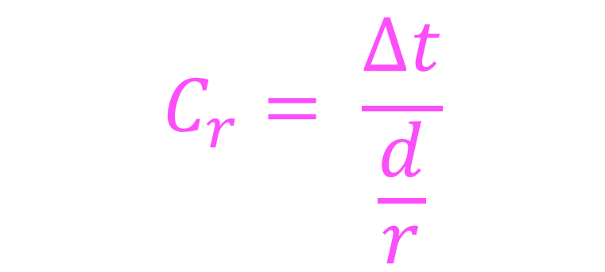
Thank you!
?
Cammie R Newmyer
719-588-4570
Newmyer.mtms@gmail.com
GitHub link
$$C_{r}= \frac{∆t}{\frac{d}{r}}$$

